Slide 1
Intelligent Patterning
and problem solving
Tom Carter
CSU Stanislaus
December 27, 2018
Intelligent Patterning
1 / 15

Slide 2
Brief overview
1 General problem solving
2
Pattern recognition
3
Symbols and signs
4
Intelligent patterning
5
Some history
6 Making things look right
7
What’s wrong in computing today
8
The intelligent mathematical assistant
Intelligent Patterning
1 / 15

Slide 3
General problem solving
General problem solving
Understanding the problem
1
Problem context and statement of the problem
Solving the right problem (ill-posed and ill-conditioned problems) Preconceptions
Language and restating the problem
2
3
4
The role of experience
1
Similar problems and analogy Appropriate tools
Specific experience
2
3
Intelligent Patterning
1 / 15

Slide 4
Three basic methods
General problem solving
1
Plug and grind Guess and prove Look it up
2
3
Hypothesis generation and testing
1
Flexibility and freedom — willingness to try and fail Recognizing blind alleys, and the value of exploring Appropriate hypotheses
Lateral thinking
2
3
4
Intelligent Patterning
1 / 15

Slide 5
Recognizing solutions
General problem solving
1
“A” solution vs. “the” solution Useful solutions
When a “solution” solves an un-posed, but more significant problem
2
3
Intelligent Patterning
1 / 15

Slide 6
Pattern recognition
Pattern recognition
Images (“visual patterns”) vs. “syntactic” patterns
Symbols as patterns, and symbols as pattern labels
Patterns of symbols
Hierarchies of patterns, and symbols as tools for recognizing patterns
Pattern manipulation
Learning to recognize patterns, and pattern recognition as learning
Intelligent Patterning
1 / 15

Slide 7
Pattern recognition examples
Pattern recognition
What number comes next in the sequence? 1, 1, 2, 3, 5, 8, 13, . . .
Intelligent Patterning
7 / 15

Slide 8
Pattern recognition examples
Pattern recognition
What number comes next in the sequence? 1, 1, 2, 3, 5, 8, 13, . . .
What number comes next in the sequence? 8, 5, 4, 9, 1, 7, 6, 3, . . .
Intelligent Patterning
7 / 15

Slide 9
Pattern recognition examples
Pattern recognition
What number comes next in the sequence? 1, 1, 2, 3, 5, 8, 13, . . .
What number comes next in the sequence? 8, 5, 4, 9, 1, 7, 6, 3, . . .
What letter comes next in the sequence? E, T, A, O, I, N, S, H, . . .
Intelligent Patterning
7 / 15

Slide 10
Pattern recognition examples
Pattern recognition
What number comes next in the sequence? 1, 1, 2, 3, 5, 8, 13, . . .
What number comes next in the sequence? 8, 5, 4, 9, 1, 7, 6, 3, . . .
What letter comes next in the sequence? E, T, A, O, I, N, S, H, . . .
In which row does Z go?
A, E, F, H, I, K, L, M, N, T, V, W, X, Y
B, C, D, G, J, O, P, Q, R, S, U
Intelligent Patterning
7 / 15

Slide 11
Pattern recognition examples
Pattern recognition
What number comes next in the sequence? 1, 1, 2, 3, 5, 8, 13, . . .
What number comes next in the sequence? 8, 5, 4, 9, 1, 7, 6, 3, . . .
What letter comes next in the sequence? E, T, A, O, I, N, S, H, . . .
In which row does Z go?
A, E, F, H, I, K, L, M, N, T, V, W, X, Y
B, C, D, G, J, O, P, Q, R, S, U
What letter comes next in the sequence? W, L, C, N, I, T, . . .
Intelligent Patterning
7 / 15

Slide 12
Symbols and signs
Symbols and signs
The utility and power of symbols Choosing symbols, naming and pointing Symbols as “chunking” tools
When to use symbols
1
The importance of anonymity (e.g., the lambda calculus)
Place holders (variables) Temporary and tentative symbols
2
3
Signs, symbols, content and meaning
Tom Carter (CSU Stanislaus)
Intelligent Patterning
December 27, 2018

Slide 13
Intelligent patterning
Intelligent patterning
Creativity and Art
1
Knowing when to pattern Symbol attachment and creation;
patterns/symbols as revealers and concealers
Levels of patterning
2
3
Multiple patterns and selection (x − 1)(x − 2)(x − 3) − 6
x ³ − 6x ² + 11x − 12 (x − 4)(x ² − 2x + 3)
Adaptive pattern recognition Are the patterns really there?
Tom Carter (CSU Stanislaus)
Intelligent Patterning
December 27, 2018

Slide 14
Some history
Some history
Physics
Philosophy (theory of knowledge) Mathematics
1
Matrix manipulation Topology
Algebra Lie groups
Manifolds and relativity theory
Algebraic topology
2
3
4
5
6
Tom Carter (CSU Stanislaus)
Intelligent Patterning
December 27, 2018

Slide 15
Making things look right:
Making things look right
Consider this piece of mathematics (here, and the next page). How do we get this typeset? See the following page for L^{A}T_{E}X . . .
We have the map b_{n} : Σ²U(n) → SU(n + 1)
given by
b_{n}(g, r , s) = [i (g ), v_{n}(r, s)] where i (g ) is the inclusion, [g, h] = ghg⁻¹h⁻¹
and
Tom Carter (CSU Stanislaus)
Intelligent Patterning
December 27, 2018

Slide 16
Making things look right
v_{n} (r , s) =

0
1
2

α
0
0 0 · · ·
α 0 · · ·
β(−α)⁰β α · · ·
. . .
0
0
0
β(−α)
β(−α)
β(−α)

β(−α) β


β(−α)¹β


.
.
.
.
.

.
.
.
.
.

.
. .
.
.

.
.
.
.
.

.
.
.
.
.

.
.
.
· · · · · ·
· · · · · ·
.
α β(−α)

.


β(−α)
n−1
β β(−α)^{n−2}β
n 
−(−α)^{n}β
−(−α)^{n−1}β
−(−α)⁰β
−(−α)^{n}
where
α = α(r, s) = cos(πr ) + i sin(πr ) cos(πs)
β = β(r, s) = i sin(πr ) sin(πs)
Tom Carter (CSU Stanislaus)
Intelligent Patterning
December 27, 2018

Slide 17
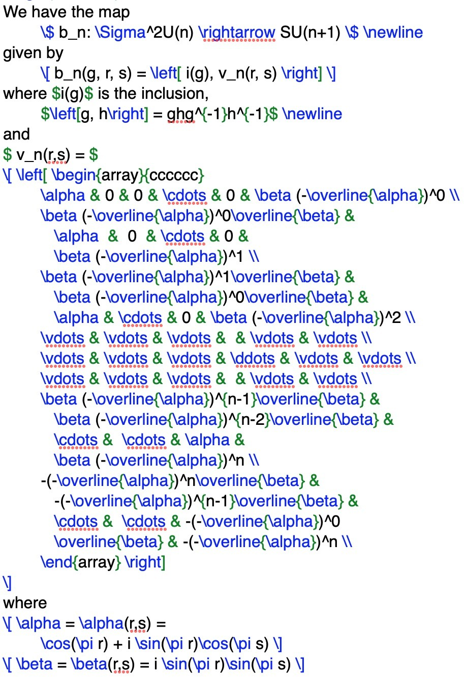
Making things look right
Tom Carter (CSU Stanislaus)
Intelligent Patterning
December 27, 2018

Slide 18
What’s wrong in computing today
What’s wrong in computing today
Not enough resolution on displays (seems mostly solved . . . :-) Not enough processing power and memory
Not enough parallelism
Software tools are (largely) “flat” and sequential rather than hierarchical
Tom Carter (CSU Stanislaus)
Intelligent Patterning
December 27, 2018

Slide 19
The intelligent mathematical assistant
The intelligent mathematical assistant
Adaptive symbolic input and output
Strong basic skills (all of arithmetic through college calculus and elementary discrete structures)
First order logic capabilities
Adaptive “patterning” and “symboling”
Elementary hypothesis generation and testing
Tom Carter (CSU Stanislaus)
Intelligent Patterning
December 27, 2018

